Slide 1
Systems Analysis and Design
Chapter 4-5-6-7
Part -4
Chapter 6
Object Modeling

Slide 2
Chapter Objectives
Explain how object-oriented analysis can be used to describe an information system
Define object modeling terms and concepts, including objects, attributes, methods, messages, classes, and instances
Explain relationships among objects and the concept of inheritance
Draw an object relationship diagram

Slide 3
Chapter Objectives
Describe Unified Modeling Language (UML) tools and techniques, including use cases, use case diagrams, class diagrams, sequence diagrams, state transition diagrams, and activity diagrams
Explain the advantages of using CASE tools in developing the object model
Explain how to organize an object model

Slide 4
Introduction
You learn about object-oriented analysis, which is another way to view and model system requirements
You use object-oriented methods to document, analyze, and model the information system

Slide 5
Overview of Object-Oriented Analysis
Object-oriented (O-O) analysis
Object
Object-oriented analysis is a popular approach that sees a system from the viewpoint of the objects themselves as they function and interact
Object model

Slide 6
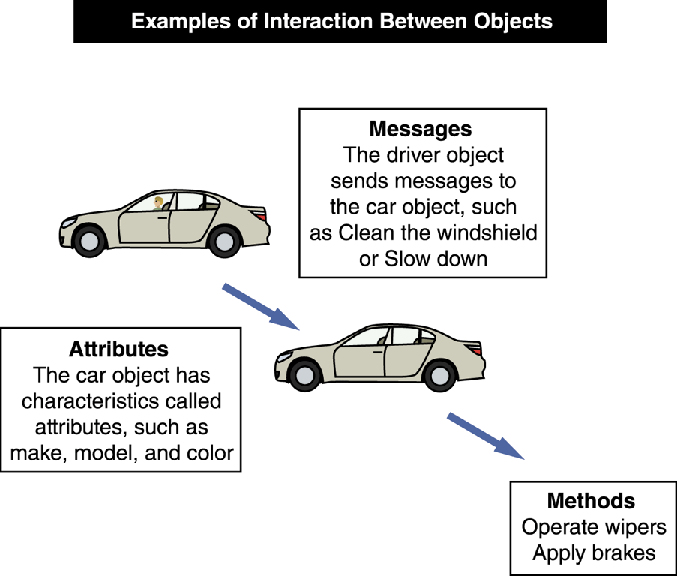
Overview of Object-Oriented Analysis
Object-Oriented Terms and Concepts
Unified Modeling Language (UML)
Attributes
Methods
Message
Class
Instance

Slide 7
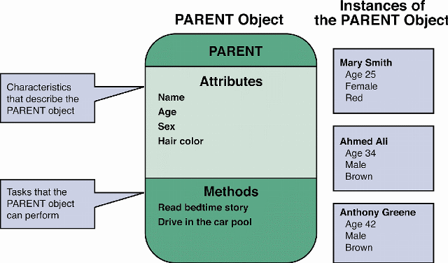
Overview of Object-Oriented Analysis
Objects

Slide 8
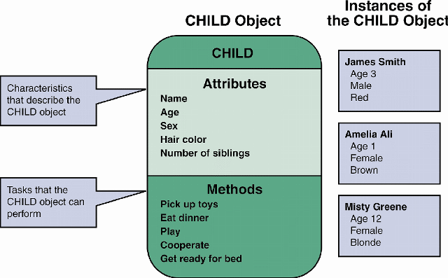
Overview of Object-Oriented Analysis
Objects

Slide 9
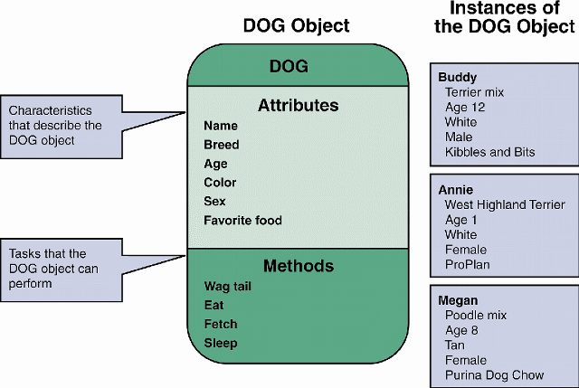
Overview of Object-Oriented Analysis
Objects

Slide 10
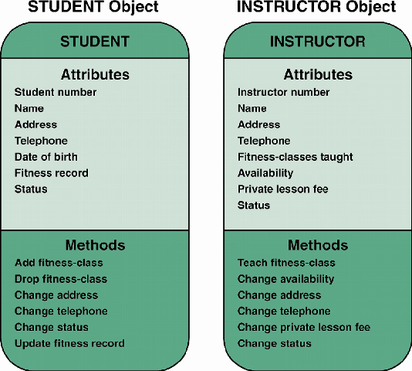
Overview of Object-Oriented Analysis
Objects

Slide 11
Overview of Object-Oriented Analysis
Attributes
If objects are similar to nouns, attributes are similar to adjectives that describe the characteristics of an object
Some objects might have a few attributes; others might have dozens
State

Slide 12
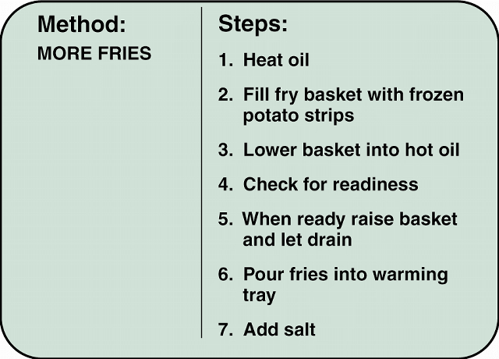
Overview of Object-Oriented Analysis
Methods
A method defines specific tasks that an object can perform
Just as objects are similar to nouns and attributes are similar to adjectives, methods resemble verbs that describe what and how an object does something

Slide 13
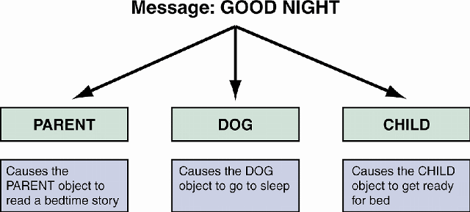
Overview of Object-Oriented Analysis
Messages
Polymorphism
Black box
Encapsulation

Slide 14
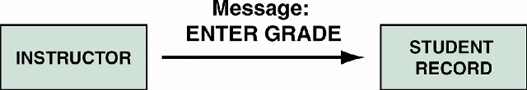
Overview of Object-Oriented Analysis
Messages
A major advantage of O-O designs is that systems analysts can save time and avoid errors by using modular objects, and programmers can translate the designs into code, working with reusable program modules that have been tested and verified

Slide 15
Overview of Object-Oriented Analysis
Classes
An object belongs to a group or category called a class
All objects within a class share common attributes and methods
Subclasses
Superclass

Slide 16
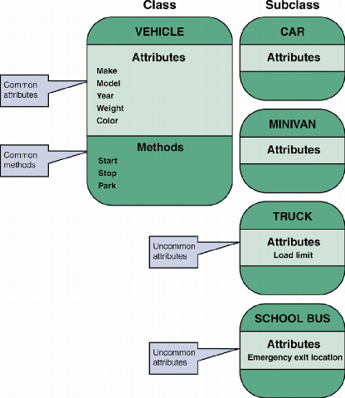
Overview of Object-Oriented Analysis
Classes

Slide 17
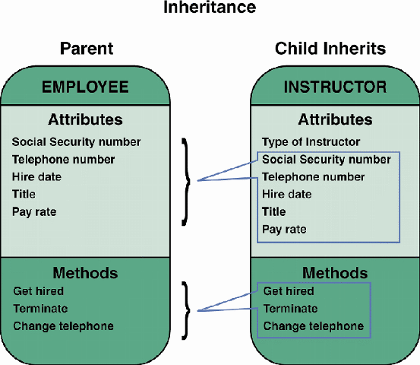
Relationships Among Objects and Classes
Inheritance
Child
Parent

Slide 18
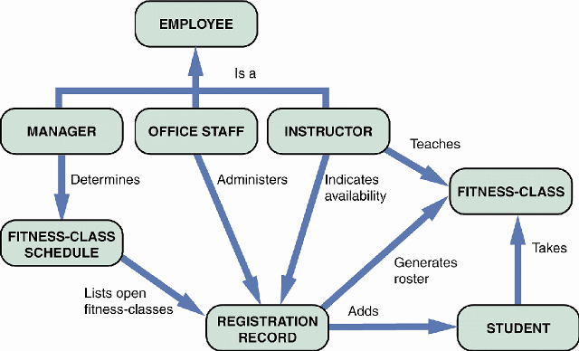
Relationships Among Objects and Classes
Object Relationship Diagram

Slide 19
Object Modeling with the Unified Modeling Language
The UML uses a set of symbols to represent graphically the various components and relationships within a system
It mainly is used to support object-oriented systems analysis and to develop object models

Slide 20
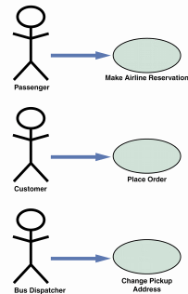
Object Modeling with the Unified Modeling Language
Use Case Modeling
Actor
Symbol for a use case is an oval with a label that describes the action or event
Use cases also can interact with other use cases

Slide 21
Object Modeling with the Unified Modeling Language
Use Case Modeling
When the outcome of one use case is incorporated by another use case, we say that the second case uses the first case
Use case description
When you identify use cases, try to group all the related transactions into a single use case

Slide 22
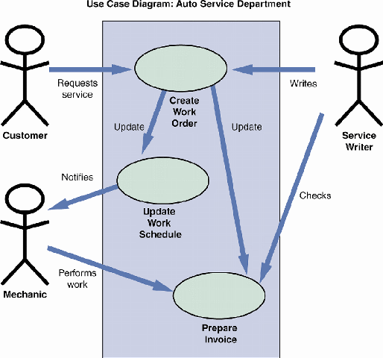
Object Modeling with the Unified Modeling Language
Use Case Diagrams
Use case diagram
System boundary
After you identify the system boundary, you place the use cases on the diagram, add the actors, and show the relationships

Slide 23
Object Modeling with the Unified Modeling Language
Class Diagrams
Class Diagram
Evolves into a physical model and finally becomes a functioning information system
Each class appears as a rectangle, with the class name at the top, followed by the class’s attributes and methods
Cardinality

Slide 24
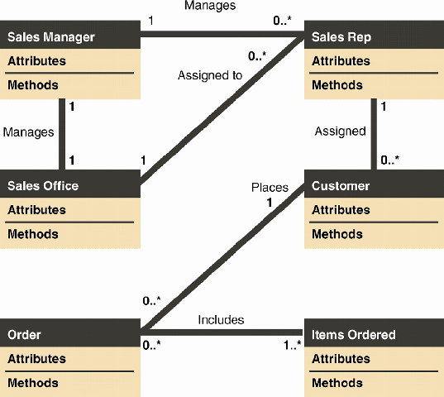
Object Modeling with the Unified Modeling Language
Class Diagrams

Slide 25
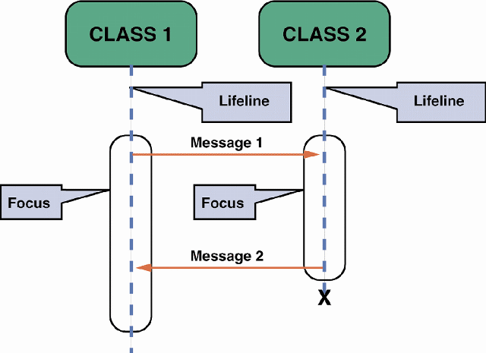
Object Modeling with the Unified Modeling Language
Sequence Diagrams
Sequence diagram
Include symbols that represent
Classes
Lifelines
Messages
Focuses

Slide 26
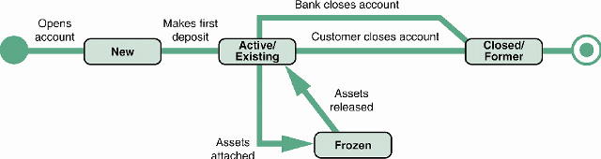
Object Modeling with the Unified Modeling Language
State Transition Diagrams

Slide 27
Object Modeling with the Unified Modeling Language
State Transition Diagrams
The small circle to the left is the initial state, or the point where the object first interacts with the system
Reading from left to right, the lines show direction and describe the action or event that causes a transition from one state to another
The circle at the right with a hollow border is the final state

Slide 28
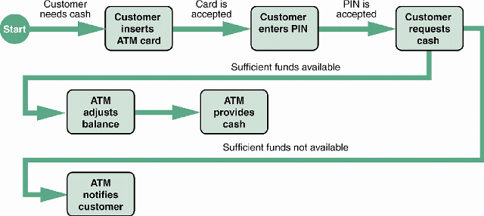
Object Modeling with the Unified Modeling Language
Activity Diagrams

Slide 29
Object Modeling with the Unified Modeling Language
Activity Diagrams
Sequence diagrams, state transition diagrams, and activity diagrams are dynamic modeling tools that can help a systems analyst understand how objects behave and interact with the system

Slide 30
Object Modeling with the Unified Modeling Language
CASE Tools
Object modeling requires many types of diagrams to represent the proposed system
Creating the diagrams by hand is time-consuming and tedious, so systems analysts rely on CASE tools to speed up the process and provide an overall framework for documenting the system components

Slide 31
Organizing the Object Model
You should develop an object relationship diagram that provides an overview of the system
You should organize your use cases and use case diagrams so they can be linked to the appropriate class, state transition, sequence, and activity diagrams
It is much easier to repair a diagram now than to change the software later

Slide 32
Chapter Summary
This chapter introduces object modeling, which is a popular technique that describes a system in terms of objects
The Unified Modeling Language (UML) is a widely used method of visualizing and documenting an information system
At the end of the object modeling process, you organize your use cases and use case diagrams and create class, sequence, state transition, and activity diagrams

Slide 33
Chapter Summary
Chapter 6 complete

